Slide 1
Entity-Relationship (ER) Model
CS 4710
Database Systems

Slide 2
Super Key – Candidate Key - Primary Key
Super key – any attribute(s) that can uniquely identify a tuple
Candidate key – minimal super key
Primary key – a candidate key that is the most important key
Students_info
Identify primary key
computingID | SSN | name
mi1y | 111-11-1111 | Mickey
mi2e | 222-22-2222 | Minnie
do3d | 333-33-3333 | Donald
da4y | 444-44-4444 | Daisy
do5d | 555-55-5555 | Donald
computingID
Primary key

Slide 3
Primary Keys
A relation’s primary key uniquely identifies a single tuple
movies
title | year | length | genre
Gone with the wind | 1939 | 231 | drama
Star wars | 1977 | 124 | sciFi
Wayne’s world | 1992 | 95 | comedy
Unique
Every tuple has
The characteristics of primary keys
Not empty, not NULL
Most important candidate key
No change
Meaningful

Slide 4
Primary Keys
Some DBMSs automatically create an internal primary key if none is defined for the relation
Auto-generation of unique integer primary keys:
SEQUENCE (SQL: 2003)
movies
id | title | year | length | genre
123 | Gone with the wind | 1939 | 231 | drama
456 | Star wars | 1977 | 124 | sciFi
789 | Wayne’s world | 1992 | 95 | comedy
AUTO_INCREMENT (MySQL)

Slide 5

Foreign Keys
A foreign key specifies that an attribute from one relation has to map to a tuple in another relation
Artist(id, name, year, country)
Attribute(s) that uniquely identify a row in another table
id | name | year | country
123 | Mickey | 1992 | USA
456 | Minnie | 1992 | USA
789 | Donald | 1994 | USA
Primary key
Album(id, name, artists, year)
id | name | artists | year
11 | Mickey’s Club House | 123 | 1993
22 | Awesome Minnie | 456 | 1994
33 | Most wanted | 789 | 1995
How about 2 artists (123 and 789)?
33 | Most wanted | 123 | 1995
33 | Most wanted | 789 | 1995
Foreign key

Slide 6
Foreign Keys
ArtistAlbum(artist_id, album_id)
Artist(id, name, year, country)
artist_id | album_id
123 | 11
123 | 33
789 | 33
456 | 22
id | name | year | country
123 | Mickey | 1992 | USA
456 | Minnie | 1992 | USA
789 | Donald | 1994 | USA
PK
PK
Album(id, name, year)
id | name | year
11 | Mickey’s Club House | 1993
22 | Awesome Minnie | 1994
33 | Most wanted | 1995
How about a primary key?
PK

Slide 7
(Additional) Practice Activity
This is an open-ended activity, consisting of 3 relations. For each relation, think about the data to be stored. You should also consider the type of data. Write a schema for each relation. Feel free to make any reasonable assumption.
Consider the following description. Write schemas that represent the data models for the given description.

Slide 8
(Additional) Practice Activity (2)
Relation: Movies
Each movie has a title and year; title and year together uniquely identify the movie. Length and genre are maintained for each movie. Each movie is associated with a studioName which tells us the studio that owns the movie, and producerC# which is an integer that represents the producer of the movie.
Relation: MovieStar
This relation tells us something about stars. It maintains the name of the movie star, address, gender, and birthdate. The gender can be a single character (M or F). Birthday is of type “date,” which might be a character string of a special form.
Relation: StarsIn
This relation connects movies to the stars of that movie, and likewise connects a stars to the movies in which they appeared. A star might appear in multiple movies in one year.

Slide 9
Intro to ER Diagram

Slide 10
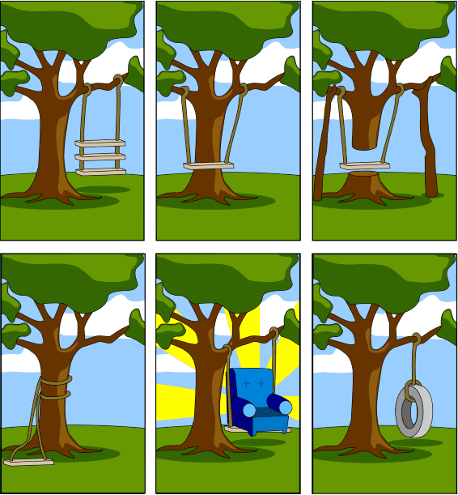

I’ve Got Great Ideas for An App
How the customer explained it
How the project leader understood it
How the analyst designed it
In database design, communication is key
Many people are involved in the design process
We need a way to communicate our ideas
How the developer built it
How the sale executive described it
What the customer really needed
[modified from image by Janetti, https://www.cleanpng.com/png-project-management-project-manager-architectural-e-5729993/download-png.html]

Slide 11

Overview: Creating DB App
Design database schema
Ideas / data
+
Design program that access and update data
High-level design
+
Design security schema to control access of data
Database model
Database design = process of organizing data into a
database model by considering data to be stored and the interrelationship of the data

Slide 12
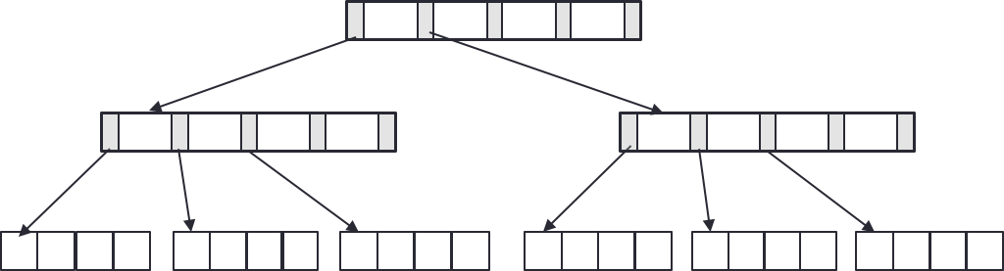
Database Design Process
Interact with users and domain experts to characterize the data
Translate requirements into conceptual model (E-R diagrams)
Convert the model to relational model (schema and constraints)
Normalize and develop conceptual (logical) schema of the database
Develop physical schema (partitioning and indexing)

Slide 13
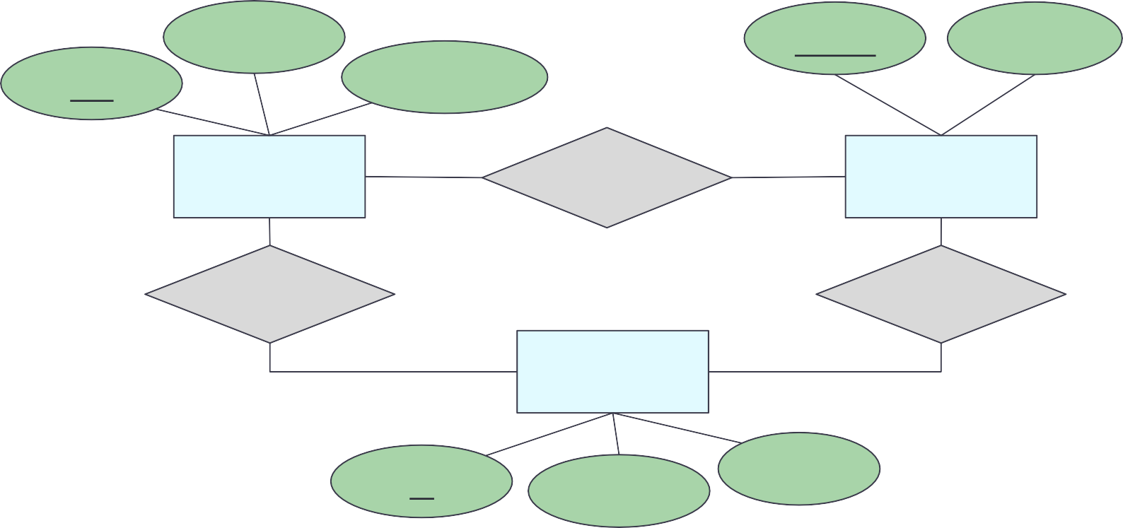
Entity-Relationship Model
E-R diagram – high-level design model representing a database as a collection of entities and relationships among entities
name
name
address
pid
description
product
makes
company
buys
works-for
person
id
address
name

Slide 14
E-R Diagram: Building Blocks
(strong) Entity set
Attribute Relationship
Weak entity
Subclass
is a
Note: colors are not part of E-R Diagram. They simply are used to increase readability.

Slide 15


Entity and Entity Sets
Entity ~an object (thing to keep track to run the business)
Entity set ~a class (~table, a collection of things of the same kind)
Some entity set
examples
Student
Building
Doctor
Treatment
Course
Faculty
Patient
Nurse

Slide 16
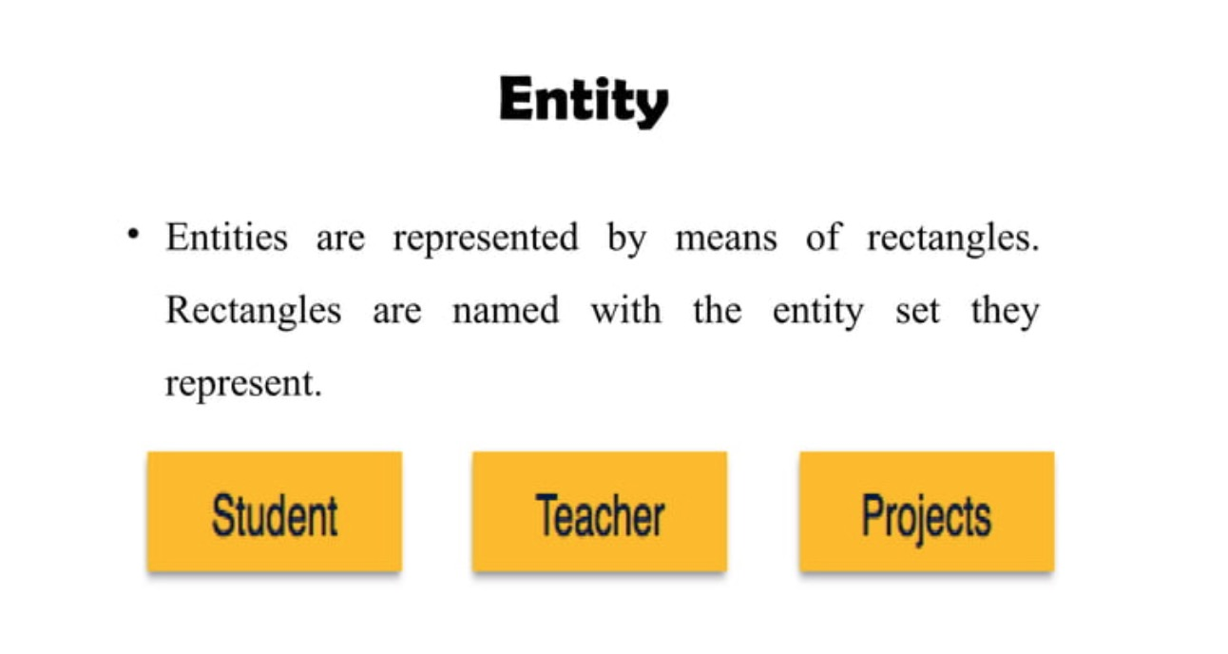

Slide 17
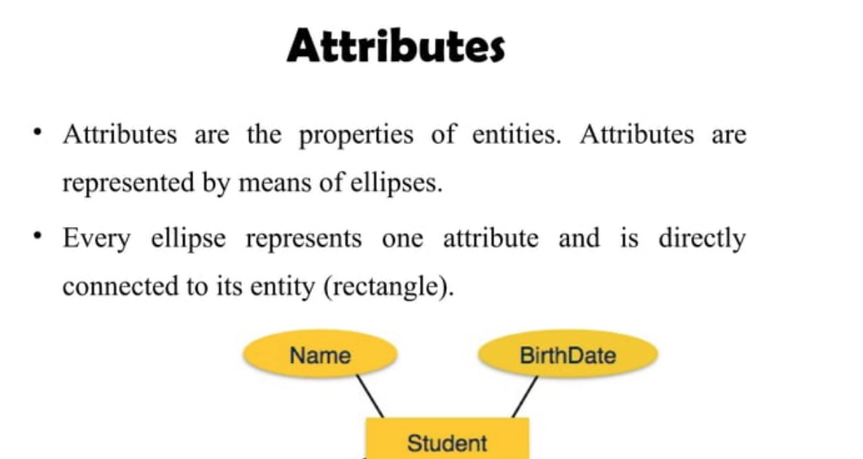

Slide 18


Entity Sets and Attributes
Every entity set should have a primary key
An entity is an object that is distinguishable from other types of objects
person
id
address
name
An attribute has domain specifying acceptable values
Underline indicates that the attribute is part of the primary key
E-R model is a static concept, involving the structure of data and not the operations on data.
Thus, no methods associated with an entity set

Slide 19
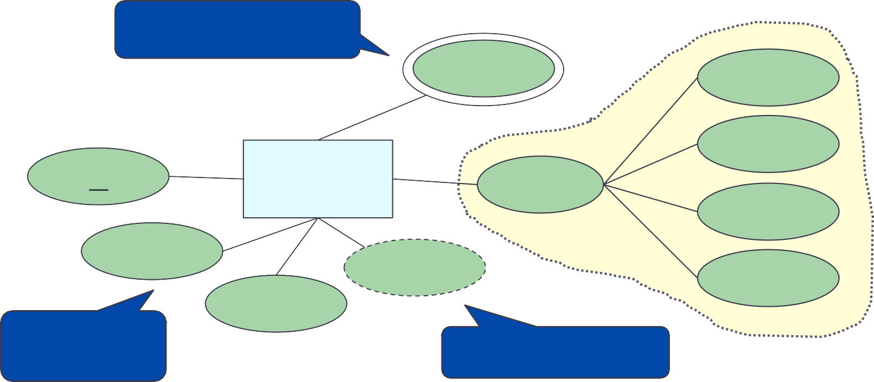
Attributes
Single-valued attribute – allows a single value
Multi-valued attribute – allows multiple values at the same time
Derived attribute –can be calculated from one or more attributes
Composite attribute – consists of multiple values
Multi-valued attribute
phone
street
Composite attribute
city
id
person
address
Ensure atomic
state
name
age
zipcode
DOB
Single-valued attribute
Derived attribute

Slide 20
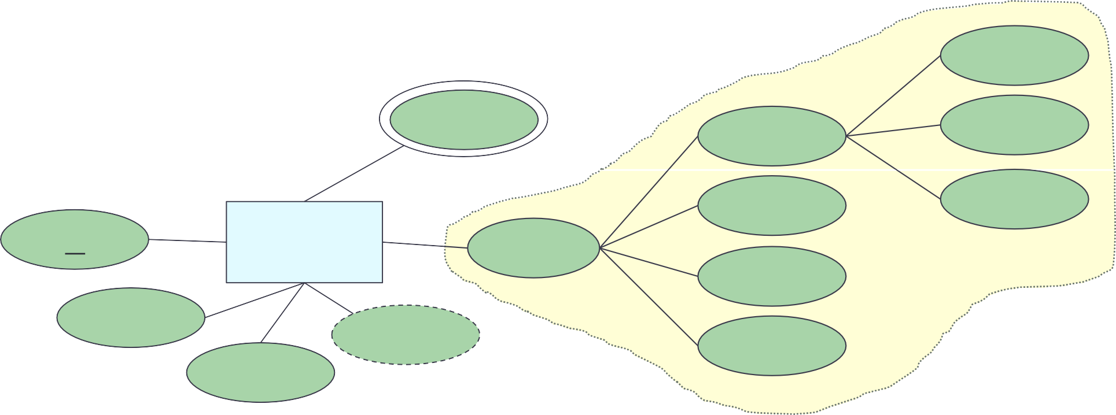
Attributes
Composite attribute – can have as many levels as needed
number
phone
street
name
city
apt-number
id
person
address
state
name
age
zipcode
DOB

Slide 21
Let’s try: Movie-Database
Identify entity, entity sets, and attributes
Object
Movies
Each movie has a title and year; title and year together uniquely identify the movie. Length and genre are maintained for each movie. Each movie is associated with a studioName which tells us the studio that owns the movie, and producerC# which is an integer that represents the producer of the movie.
Object
MovieStars
MovieStars tells us something about stars. It maintains the
name
of the
movie star, address, and
The gender can be a single
gender,
birthdate.
character (M or F). Birthday is of type “date,” which might be a character string of a special form.

Slide 22
Let’s try: Movie-Database
Movies
Movies
Title | Year | Length | Genre
Mickey’s Club House | 1939 | 231 | drama
Awesome Minnie | 1977 | 124 | sciFi
Most wanted | 1992 | 95 | comedy
title
genre
year
length
MovieStars
name | address | gender | birthdate
Mickey | 11 Somewhere, Charlottesville, VA, 22903 | F | 01/01/1911
Minnie | 22 Another place, Fairfax, VA, 22030 | M | 02/02/1912
Donald | 33 Nowhere, Charlottesville, 22911 | F | 03/03/1913
MovieStars
name
birthdate
address
gender
Note: instances do not exist in E-R. These tables are only to help visualize the database being designed.

Slide 23
Note: Instances of E-R Diagram
E-R model is used to design a database. The database is not implemented. Therefore, the instance of E-R diagram never exists in the sense that a relation’s instances exist in a relational model.
However, it is often useful to visualize the database being designed as if it existed.

Slide 24
Relationships
Connections among two or more entity sets
Binary relationships – connections between two entity sets
Multi-way relationships (u-ary) – connections involving more than two entity sets

Slide 25
Binary Relationships
If A and B are sets, a relationship R is a subset of A X B
product
company
pid | name | description |  | name | address
11 | Beyblade | … |  | Dreamwork | …
22 | Trolls | … |  | Hashbro | …
… | … | … |  | Nyform | …
name
name
address
pid
description
product
makes
company
Note: instances do not exist in E-R. These tables are only to help visualize the database being designed.

Slide 26
Cardinality (or Multiplicity)
A binary relationship can connect any member of one of its entity sets to any number of members of the other entity set
One-to-one
One-to-many
Many-to-one
Many-to-many

Slide 27
Cardinality: One-to-One
product company
pid | name | description |  | name | address
11 | Beyblade | … |  | Dreamwork | …
22 | Trolls | … |  | Hashbro | …
… | … | … |  | Nyform | …
product
makes
company
Arrow pointing to the entity that is constrained to one
Arrow pointing to the entity that is constrained to one
Each product can be made by at most one company. Each company can make at most one product.
“at most one” – Guarantee existence?
Note: instances do not exist in E-R. These tables are only to help visualize the database being designed.

Slide 28
Example
each student has one backpack, and that each backpack belongs to one student.
One person has one passport, and the passport can only be used by one person.
One family lives in one house, and the house contains one family.
One person owns one car, and the car is owned by one person.

Slide 29
Cardinality: One-to-Many
product company
pid | name | description |  | name | address
11 | Beyblade | … |  | Dreamwork | …
22 | Trolls | … |  | Hashbro | …
… | … | … |  | Nyform | …
product
makes
company
Arrow pointing to the entity that is constrained to one
Each product can be made by many companies. Each company can make at most one product.
“at most one” and “many” – Guarantee existence?
Note: instances do not exist in E-R. These tables are only to help visualize the database being designed.

Slide 30
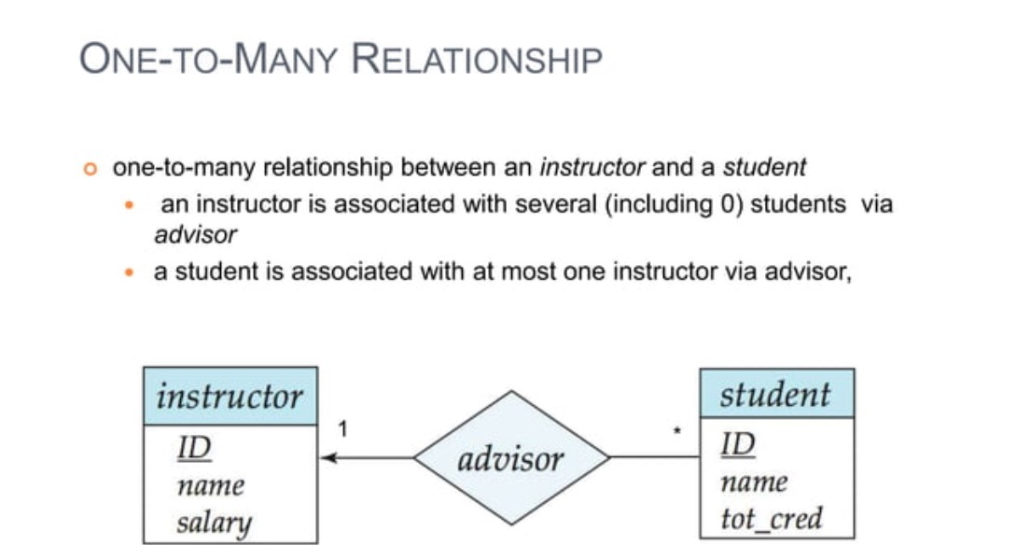
Cardinality: One-to-Many

Slide 31
Cardinality: Many-to-One
product company
pid | name | description |  | name | address
11 | Beyblade | … |  | Dreamwork | …
22 | Trolls | … |  | Hashbro | …
… | … | … |  | Nyform | …
product
makes
company
Arrow pointing to the entity that is constrained to one
Each product can be made by at most one company. Each company can make many products.
“at most one” and “many” – Guarantee existence?
Note: instances do not exist in E-R. These tables are only to help visualize the database being designed.

Slide 32
Example
parent-child relationship
book authors and their books
websites with multiple web pages

Slide 33
Cardinality: Many-to-Many
product company
pid | name | description |  | name | address
11 | Beyblade | … |  | Dreamwork | …
22 | Trolls | … |  | Hashbro | …
… | … | … |  | Nyform | …
product
makes
company
Each product can be made by many companies. Each company can make many products.
“many” – Guarantee existence?
Note: instances do not exist in E-R. These tables are only to help visualize the database being designed.

Slide 34
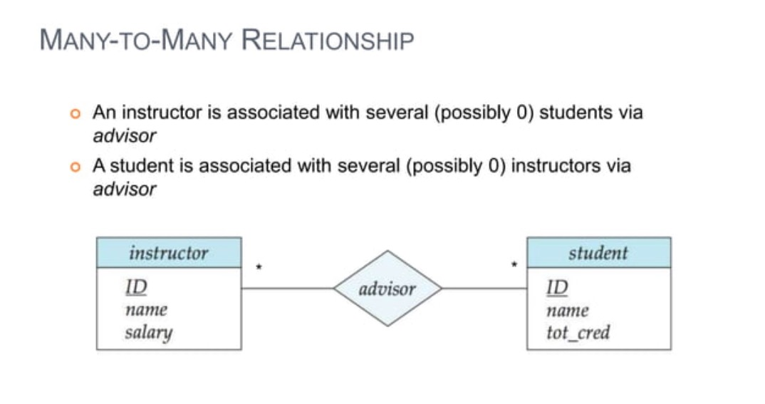

Slide 35
Example
Students and Courses
Teacher and students
Library books and borrowers

Slide 36








Let’s try: Cardinality (1)
Draw an E-R diagram to model the given image sample data. Specify the cardinality. Interpret the E-R diagram.
Was born in
was_born_in
(many-to-one)

Slide 37







Let’s try: Cardinality (2)
Draw an E-R diagram to model the given image sample data. Specify the cardinality. Interpret the E-R diagram.
Is Married to
is_married_to
(one-to-one)

Slide 38





Let’s try: Cardinality (3)
Draw an E-R diagram to model the given image sample data. Specify the cardinality. Interpret the E-R diagram.
Is mother of
is_mother_of
(one-to-many)

Slide 39
Attributes on Relationships
Relationships can have attributes
The attributes have values only when the relationship occurs
name
name
address
pid
description
product
makes
company
Use dotted line to connect an attribute to the relationship
quantity

Slide 40
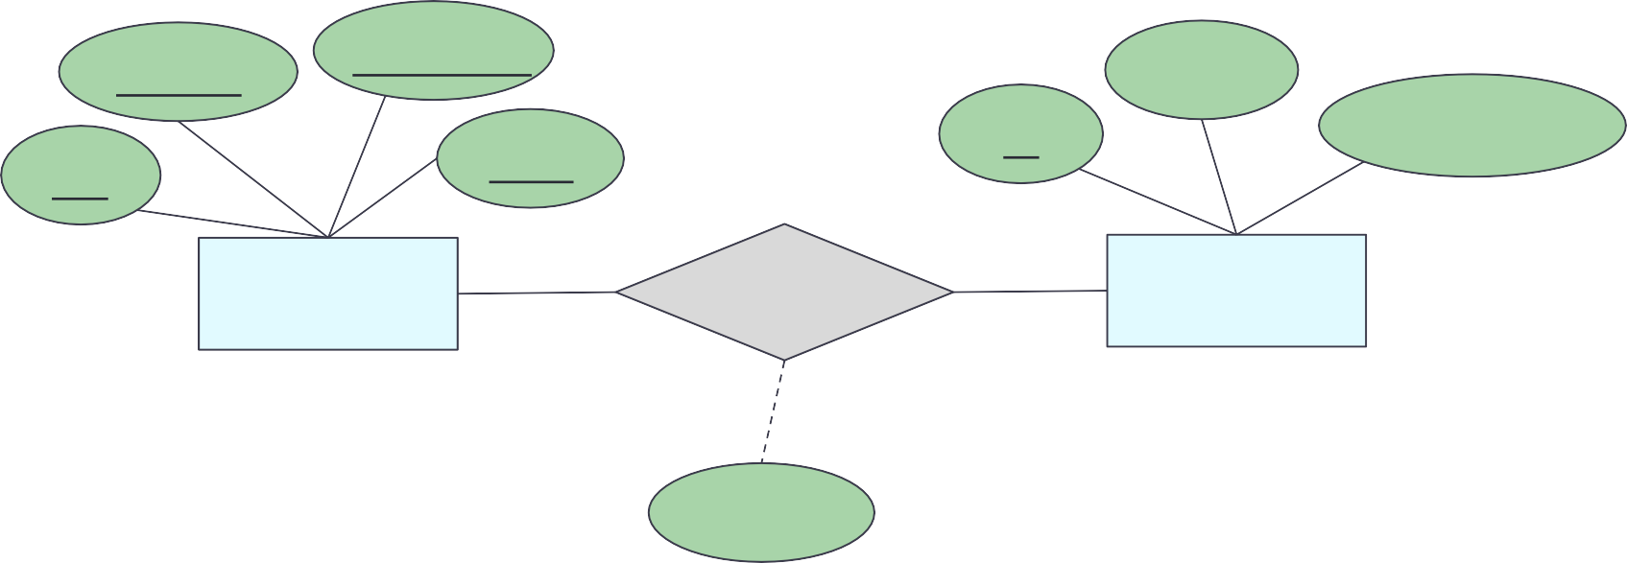
Let’s try: Attributes - Relationships
Interpret the E-R diagram.
sec_id
semester
name
id
total_credit
cid
year
course
takes
student
grade
Each student can take many courses.
Each course can be taken by many students.
A grade exists only when the student takes a course.

Slide 41
Wrap-Up
Database design process
Intro to E-R model
Entities and entity sets
Attributes: single-valued, multi-valued, derived, composite
Cardinality and participation
What’s next?
Roles in relationships
Relationships: binary, multi-way
Weak entity

